Slide 1
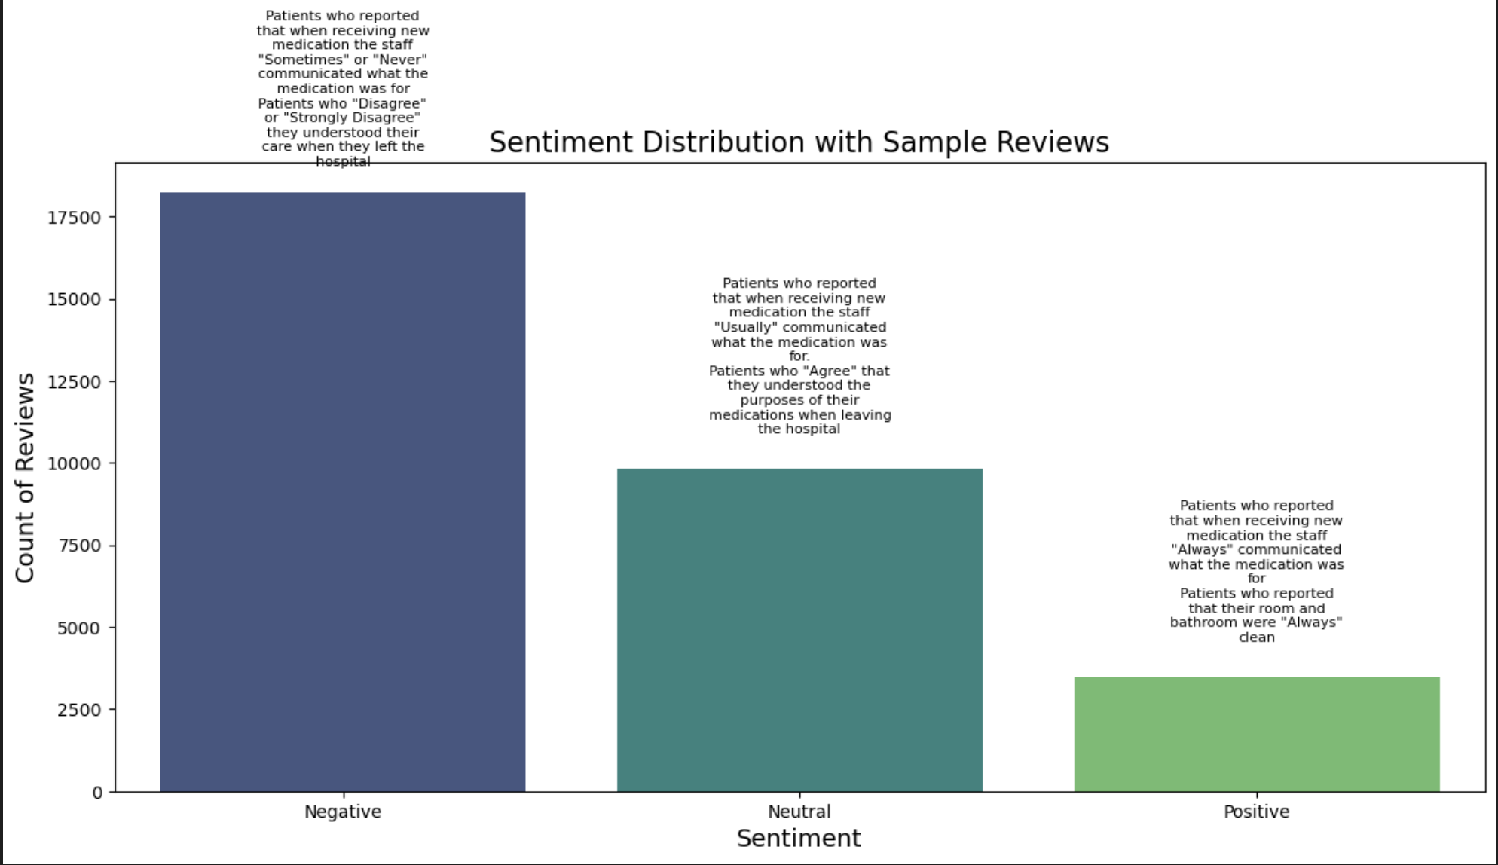

Slide 2
This bar chart visualizes the distribution of sentiment categories (Positive, Neutral, Negative) within the dataset, alongside sample reviews from each category:
X-axis (Sentiment): The three sentiment categories (Positive, Neutral, and Negative).
Y-axis (Count of Reviews): The total number of reviews that fall into each sentiment category.
Sample Reviews: Text annotations on each bar represent random samples of reviews from that sentiment category. The reviews are wrapped within a certain width so they fit neatly inside the graph.
Key Insights:
This chart allows you to understand the distribution of the sentiment in the dataset. For example, if the "Negative" bar is much higher than the "Positive" bar, it could indicate that a significant number of patients expressed dissatisfaction.
Sample reviews help contextualize what patients are actually saying, giving you a qualitative sense of what typical feedback looks like for each sentiment category. This adds more interpretability to the quantitative sentiment breakdown.

Slide 3
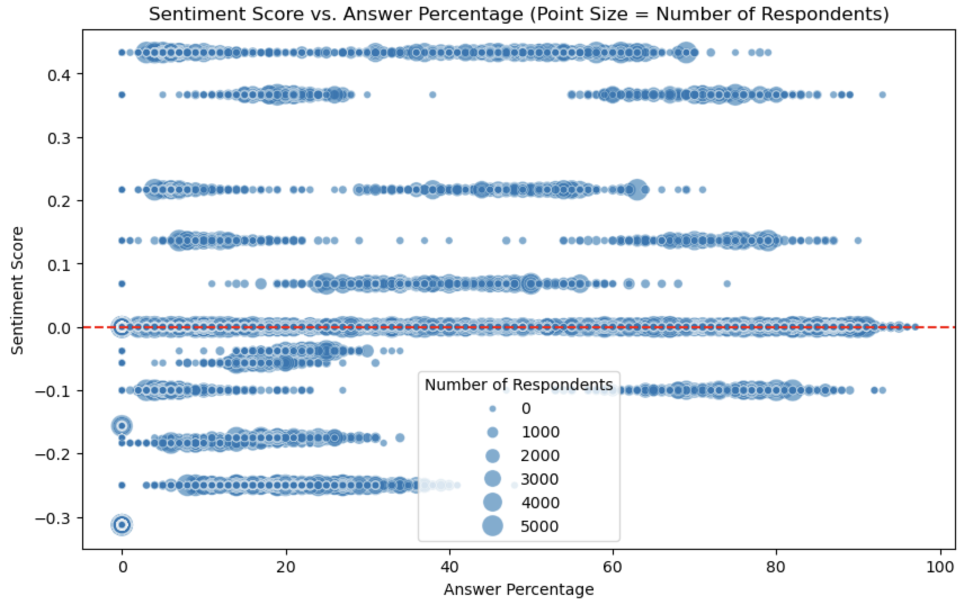

Slide 4
Description: This graph is a scatter plot where:
X-axis (HCAHPS Answer Percent): Represents the percentage of patients who responded positively to the survey questions (e.g., percentage of patients who "Strongly Agree" or "Always" with various care aspects).
Y-axis (Sentiment Score): Represents the sentiment polarity score of the text-based survey questions.
The sentiment score is calculated using the TextBlob library, where:
Positive sentiment scores indicate favorable feedback.
Negative sentiment scores indicate dissatisfaction or unfavorable feedback.
Point Size: Proportional to the number of completed surveys for that particular question, meaning larger points represent responses with more surveys (greater participation).
Alpha (Transparency): Makes the points slightly transparent to allow overlapping points to be more easily distinguishable.
Red Horizontal Line: The horizontal red dashed line at y=0 represents the boundary between negative and positive sentiment, making it easier to identify whether responses tend to be favorable or unfavorable overall.
Key Insights:
You can quickly identify the general distribution of sentiment across different answer percentages. For instance, points above the red horizontal line (sentiment = 0) reflect positive feedback, while those below it reflect negative feedback.
Larger points (more respondents) may indicate questions with significant importance or frequent responses.
Clusters near the higher end of "HCAHPS Answer Percent" may indicate that patients generally report positive experiences.

Slide 5
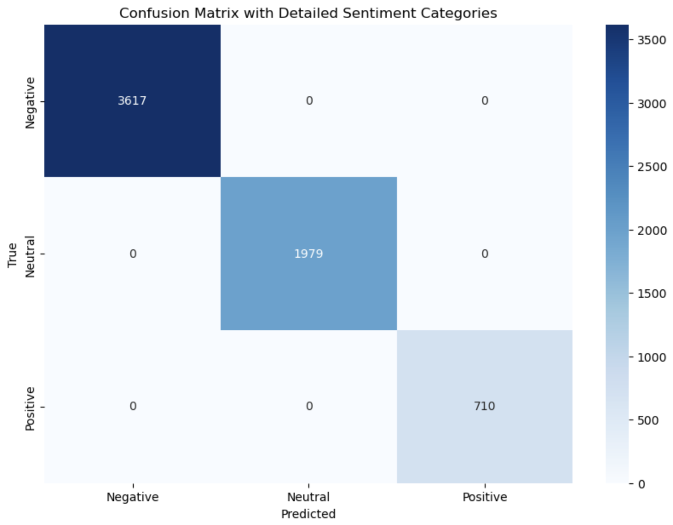

Slide 6
Description: This confusion matrix evaluates the performance of your Logistic Regression model on the test set. It shows how well your model predicted the sentiment categories (Positive, Neutral, Negative) based on the combined text features (TF-IDF) and numerical features.
X-axis (Predicted): The predicted sentiment categories by your model (Positive, Neutral, Negative).
Y-axis (True): The actual sentiment categories in the test set.
Cell Values: Each cell represents the number of data points classified into each respective combination of predicted and true categories.
Diagonal cells (top-left to bottom-right) indicate correct classifications (e.g., the number of reviews the model correctly identified as Positive, Neutral, or Negative).
Off-diagonal cells represent misclassifications, where the predicted sentiment does not match the true sentiment.
Key Insights:
The matrix highlights areas where the model performs well and where it struggles. Ideally, the diagonal should have the largest numbers, showing high accuracy.
For instance, if there is a high count in the "Neutral" row but the "Positive" or "Negative" columns, it suggests that the model often confuses neutral sentiment with either positive or negative ones, which might suggest further tuning or feature engineering is needed.

